Slide 1

Project Phase 2: Review 4
PJ22CS22 - AI CRICKET SCORE
By
P RADHA RAI - 1VI19CS066
PRAKHAR KUMAR CHANDRAKER - 1VI19CS070
SHAIK NOWSHEEN - 1VI19CS098
SHANTANU KUMAR SINGH - 1VI19CS100
Under the Guidance of
MS.VEENA G
ASSISTANT PROFESSOR

Slide 2
BIRD VIEW
2022 - 23
AI CRICKET SCORE
Introduction
Abstract
Literature Survey
Comparative analysis of the survey
Problem Statement
System Requirements
Design Methodology
Module Description
System Testing
Project Demonstration
Project Outcome
Applications
References
2

Slide 3
INTRODUCTION
2022 - 23
AI CRICKET SCORE
Gesture Recognition pertains to recognizing meaningful expressions of motion by a human.
The applications of gesture recognition are manifold.
Ranging from sign language through medical rehabilitation, monitoring patients, sports gesture analysis,etc.
In Cricket, the Umpire has the authority to make important decisions about events on the field.
The Umpire signals important events using unique hand on signals and gestures.
The primary intention of our work is to design and develop a new robust method for Umpire.[1]
3

Slide 4
ABSTRACT
AI CRICKET SCORE
2022 - 23
Cricket is the 2nd most famous sports in Asia, 4th in Europe and also 2nd most famous sport in the whole world.
From 19th century the same old manual method is being used to update the scoreboard, which is a great burden for the scorekeeper.
The basic score updating process is still the same and performed by a person manually.
So in the 21st century an automatic system is very much needed at this sector.
Using modern equipment’s and machine learning algorithms we can increase the accuracy of the decision and provide flawless result that the naked eye misses.
This motivates us to design a system which will recognize gesture of cricket umpire in real time.
4

Slide 5
LITERATURE SURVEY - 1
2022 - 23
AI CRICKET SCORE
Title: Low cost approach for Real Time Sign Language Recognition [2]
Author: Matheesha Fernando, Janaka Wijayanayaka
Methodology:
Identify the signs and convert them into text and speech using appearance based approach with a low cost web camera.
A series of image processing techniques with Hub-moment classification was identified as the best approach.
Uses fast Convex Hull Algorithm for Binary image for pattern recognization,Histogram based classification.
Advantage: Helps in identifying a low cost, affordable method that can facilitate hearing and speech impaired people to communicate with the world in more comfortable way where they can easily get what they need from the society and also can contribute to the well-being of the society.
Limitation: This project only looks at the hand postures not on hand gestures.
5

Slide 6
LITERATURE SURVEY - 2
2022 - 23
AI CRICKET SCORE
Title:Static Hand Gesture Recognition Based on Convolutional Neural Networks[3]
Author: Raimundo F. Pinto Jr. , Carlos D. B. Borges, Antˆonio M. A. Almeida ,
and I´alis C. Paula Jr.
Methodology:
Proposes a gesture recognition method using convolutional neural networks.
The procedure involves the application of morphological filters, contour generation, polygonal approximation, and segmentation during preprocessing, in which they contribute to a better feature extraction.
Segmentation algorithms can be implemented to separate, colors, textures, points, lines, discontinuities, borders, among others.
Advantage: Proposed methodology are much simpler and have a lower computational cost.
Limitation: The proposed methodology approaches only cases of gestures present in static images
6

Slide 7
LITERATURE SURVEY - 3
2022 - 23
AI CRICKET SCORE
Title: Hand Gesture Recognition Systems with the Wearable Myo Armband [4]
Author: Engin Kaya, Tufan Kumbasar
Methodology:
The hand gesture recognition systems deal with identifying a given gesture performed by the hand.
Utilized machine learning techniques to recognize the hand gestures.
Seven different time domain features are extracted from the raw EMG signals using sliding window approach to get distinctive information.
The performance of kNN, SVM and ANN algorithm will be compared.
Advantage: Achieve good accuracy.
Limitation: Need to test the proposed method with recording signals from different people and for more complicated hand gestures.
7

Slide 8
LITERATURE SURVEY - 4
2022 - 23
AI CRICKET SCORE
Title:Gesture Recognition to Make Umpire Decisions [5]
Author: Lesha Bhansali ,Meera Narvekar
Methodology:
The Umpire gesture Recognition System aims squarely to introduce a more robust technology to show Umpire choices with the assistance of Gesture Recognition and trailing of hand movement of the Umpire.
This technology helps to alleviate the burden of the scorekeepers.
The authors tested the subsequent six gestures particularly OUT, SIX, NEWBALL, NO-BALL, DEAD_BALL, FOUR.
Edge detection algorithms which emphasizes edges and transitions.
Advantage: Capable of recognising a group of six umpire gestures from the game of cricket.
Limitation: No performance of segmenting gestures.
8

Slide 9
LITERATURE SURVEY - 5
2022 - 23
AI CRICKET SCORE
Title: Automatic Labeling of Sports Video Using Umpire Gesture Recognition [6]
Author: Graeme S. Chambers, Svetha Venkatesh, and Geoff A.W. West.
Methodology:
Annotating sports videos Data from accelerometers is used to augment sports video.
Umpires in the game wear wrist bands.
A hierarchical hidden Markov model to solve the problem of automatic segmentation and robust gesture classification.
The algorithm proceeds as follows: for each period of movement ahead in time (up to 10sec) of the start of a candidate gesture, calculate the likelihood of each model for that region.
Advantage:The system performs well overall with the exception of handling unknown movements which have similarities to known movements.
Limitation:Filler ratio requires further investigation for deciding when a known gesture occurs.
9

Slide 10
LITERATURE SURVEY - 6
2022 - 23
AI CRICKET SCORE
Title: Vision-Based Sign Language Translation Device [7]
Author: Yellapu Madhuri, Anitha.G, Anburajan.M
Methodology:
This report presents a mobile Vision-Based Sign Language Translation Device for automatic translation of Indian sign language into speech in English to assist the hearing and/or speech impaired people to communicate with hearing people.
This system is broken down into three main parts
a) Image acquisition
b) Image processing to extract features for recognition
c) Recognition stage where signs are identified and audio output is given.
Sign language is recognized using Lab View Software.
Advantage: Translator between deaf and people who do not understand sign language.
Limitation: Doesn’t focus on facial expressions.
10

Slide 11
LITERATURE SURVEY - 7
2022 - 23
AI CRICKET SCORE
Title: RGB-H-CbCr Skin Color Model for Human Face Detection [8]
Author: Nusirwan Anwar bin Abdul Rahman, Kit Chong Wei and John See
Methodology:
This paper presents a novel skin color model, RGB-H-CbCr for the detection of human faces.
Skin regions are extracted using a set of founding rules based on the skin color distribution obtained from a training set.
The proposed scheme was also compared with the well-known AdaBoost face detector/classifier by Viola and Jones.
The proposed scheme is able to reach comparable standards to that achieve by the AdaBoost algorithm (90.17%) on the similar data set.
Advantage:Brightness and illumination conditions can be effictively dealt.
Limitation: Low success of a robust face detector.
11

Slide 12
LITERATURE SURVEY - 8
2022 - 23
AI CRICKET SCORE
Title: A wearable biosensing system with in-sensor adaptive machine learning for hand gesture recognition [9]
Author: Ali Moin , Andy Zhou, Abbas Rahimi , Alisha Menon.
Methodology:
Wearable devices that monitor muscle activity based on surface electromyography could be of use in the development of hand gesture recognition applications.
Most devices with local processing cannot offer training and updating of the machine-learning model during use, resulting in suboptimal performance under practical conditions.
The system can classify 13 hand gestures with 97.12% accuracy.
A high accuracy (92.87%) is preserved on expanding to 21 gestures.
An HD computing algorithm31 for training and inference of hand gestures.
Advantage: Low-cost and low-complexity
Limitation:Clssification accuracy is less.
12

Slide 13
LITERATURE SURVEY - 9
2022 - 23
AI CRICKET SCORE
Title: A Dataset and Preliminary Results for Umpire Pose Detection Using SVM Classification of Deep Features [10]
Author: Aravind Ravi, Harshwin Venugopal, Sruthy Paul, Hamid R. Tizhoosh.
Methodology:
The umpire in cricket has the authority to make critical decisions about on-field events.
The umpire communicates important events through distinct hand signals and gestures.
They Determine four such events for classification: SIX, NO BALL, OUT and WIDE based on detecting the umpire's pose from the video frames from a cricket game.
CNN algorithm is used,the early layers learn more generic features such as shapes, edges, and colour blobs, the deeper layers learn features more specific to the original dataset.
Advantage: The proposed system is an effective solution for the application of cricket highlights generation.
Limitation: Time complexity is high.
13

Slide 14
LITERATURE SURVEY - 10
2022 - 23
AI CRICKET SCORE
Title: An Approach to Automate the Scorecard in Cricket with Computer Vision and Machine Learning [11]
Author: Md. Asif Shahjalal, Zubaer Ahmad, Rushrukh Rayan, Lamia Alam.
Methodology:
This form of sports is widely played in more than 125 countries recognized by the International Cricket Council.
One of the most challenging issues that first initiates the discussion on its prosperity is the duration of the game.
Average successful rate is considered over this chart than mean value will be 91.06%.
Haar-Cascade classifier algorithm is used to classify a specific type of object.
Advantage: This proved to be a very simple but efficient algorithm for umpires gesture detection.
Limitation: Multiple classifiers were need to be trained in order to make it work.
14

Slide 15
2022 - 23
AI CRICKET SCORE
LITERATURE SURVEY - 11
Title: A Color Hand Gesture Database for Evaluating and Improving Algorithms on Hand Gesture and Posture [12]
Recognition
Author: Farhad Dadgostar, Andre L. C. Barczak, Abdolhossein Sarrafzadeh.
Methodology: Image database of hand posture and gesture images.
Details of the automatic segmentation and clipping of the hands are also discussed in this paper.
OpenCV Algorithm and Boundary Detection Algorithm is used.
Advantage: Automatically vary the lighting in all directions and even produce very complex patterns of lighting by introducing more than one source of light.
Limitation: Unless some special gadgets are used to control the lighting, it is very difficult to vary the positions of the light fairly along the three axis.
15

Slide 16
COMPARATIVE ANALYSIS
2022 - 23
AI CRICKET SCORE
Reference | Algorithm/ Technique | Platform used | Performance Metrics | Advantage | Drawback
[2] | Convex Hull Algorithm | Linux | Hand outline, Hand contour, SIFT, SURF | Low cost, affordable method | Only looks at the hand postures not hand gestures.
[3] | CNN Algorithm | Windows, Linux | Precision,Recall,F1 score | Much simpler and lower computational cost. | cases of gestures present in static images.
[4] | KNN, SVM and ANN Algorithm | Linux | Precision,Recall,F score | Achieve good accuracy | More complicated hand gestures.
16

Slide 17
COMPARATIVE ANALYSIS
2022 - 23
AI CRICKET SCORE
Reference | Algorithm/ Technique | Platform used | Performance Metrics | Advantage | Drawback
[5] | Edge detection algorithms | Windows | Gesture Recognition | Recognising a group of six umpire gestures. | No performance segmenting gestures.
[6] | Segmentation algorithm | Linux | Known,Unknown, Recall | System performs well. | Ratio require further investigation.
[7] | Lab View Software. | Windows,Linux,IOS,Android. | Geometric Features of Hand | Translator between deaf and people who don’t understand sign language. | Doesn’t focus on facial expressions.
17

Slide 18
COMPARATIVE ANALYSIS
2022 - 23
AI CRICKET SCORE
Reference | Algorithm/ Technique | Platform used | Performance Metrics | Advantage | Drawback
[8] | RGB-H-CbCr skin colour model, AdaBoost Algorithm | Windows | FDR, DSR | Brightness & illumination can be dealt. | Low success of a robust face detector.
[9] | Neuro-Inspired Hyperdimensional Computing Algorithm | Linux | SNR | Low complexity. | Mapping are not sparse.
[10] | CNN algorithm | Windows | Accuracy of Inception V3, VGG19-FC1 | High detection accuracy. | Complex dataset.
18

Slide 19
COMPARATIVE ANALYSIS
2022 - 23
AI CRICKET SCORE
Reference | Algorithm/ Technique | Platform used | Performance Metrics | Advantage | Drawback
[11] | Haar-Cascade classifier algorithm | Windows | GD,GR,SR | Efficiency enhanced to greater. | Efficiency for dynamic Gesture Low.
[12] | Open CV | Linux, Windows | Hand posture and gesture | Vary in lighting produce complex patterns. | Gadgets needed to control the lighting,
19

Slide 20
PROBLEM STATEMENT
2022 - 23
AI CRICKET SCORE
Updating of score in cricket still is a manual process.
In the stadium in front of thousands of crowd and due to heavy noise score board updater may miss some of the umpire signals.
Human eye the score updater may miss the umpire signal.
All the news channel which updates the score of Cricket has a team for manually updating the score.
20

Slide 21
SYSTEM REQUIREMENTS
2022 - 23
AI CRICKET SCORE
Hardware Requirement:
Processor : Intel i5
Speed : 2.4 GHz
RAM : 8 GB(minimum)
Hard Disk : 160 GB
Software Requirement:
Windows OS : Windows 10
Language : Python
Tools : Jupyter Notebook
21

Slide 22
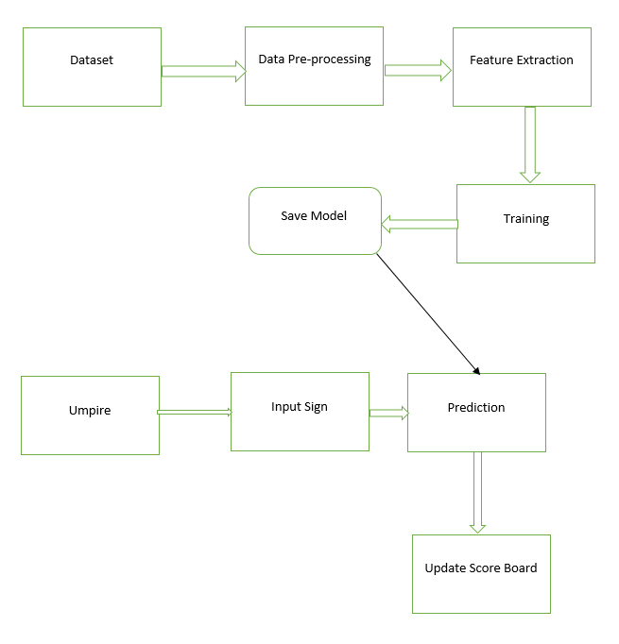
DESIGN METHODOLOGY
2022 - 23
AI CRICKET SCORE
Figure 1: System Architecture
22

Slide 23
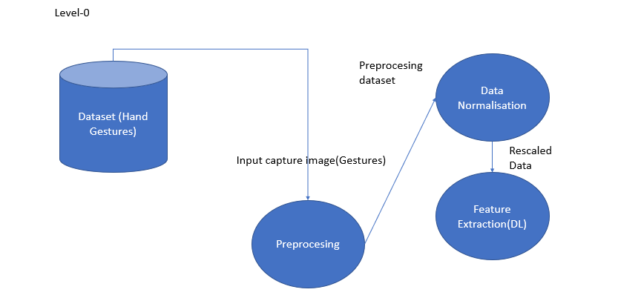
MODULE DESCRIPTION
2022 - 23
AI CRICKET SCORE
Figure 2: Data Flow Diagram
23

Slide 24
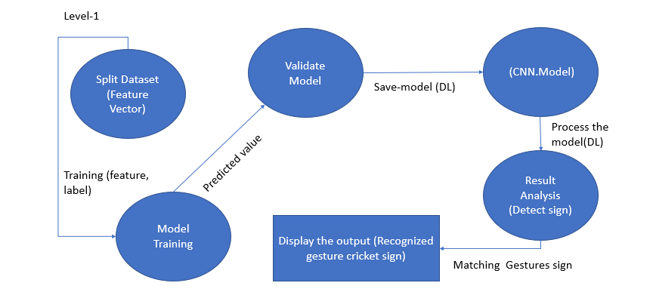
MODULE DESCRIPTION
2022 - 23
AI CRICKET SCORE
Figure 3: Data Flow Diagram
24

Slide 25
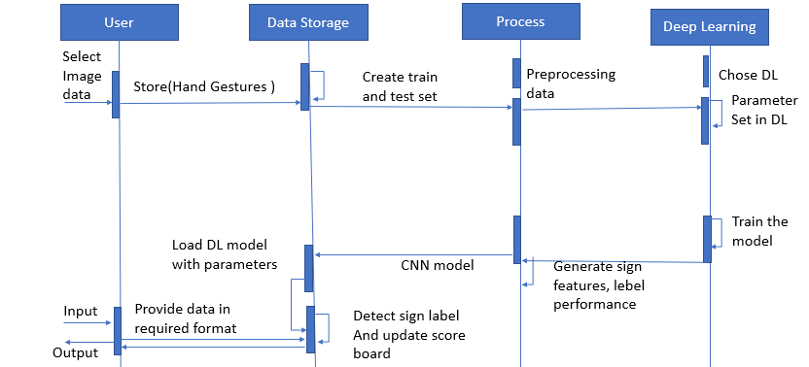
MODULE DESCRIPTION
2022 - 23
AI CRICKET SCORE
Figure 4: Sequence Diagram
25

Slide 26
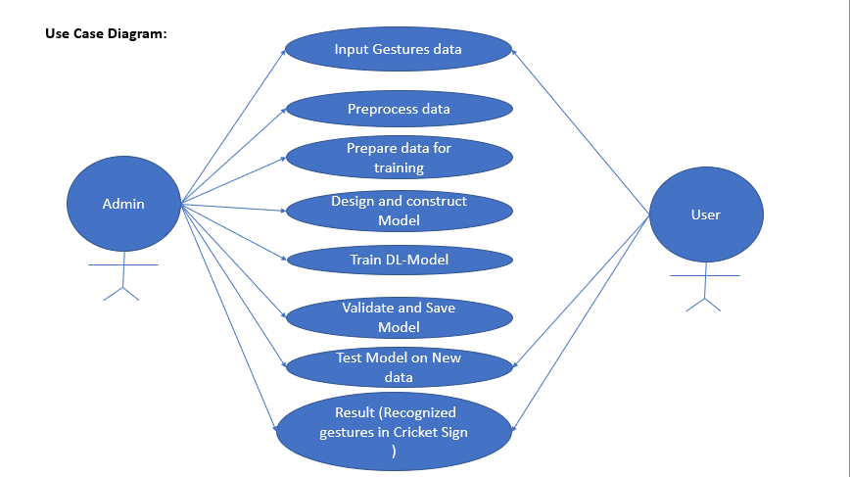
MODULE DESCRIPTION
2022 - 23
AI CRICKET SCORE
Figure 5: Use Case Diagram
26

Slide 27
SYSTEM TESTING
2022 - 23
AI CRICKET SCORE
Test Case ID. | Input Description | Expected Output | Actual Output | Remarks
1. | Capturing the Dataset | Capturing the dataset includes creating a list of images of gestures and umpire which is done by capturing each frame of video and saving it as jpg file of 50x50 pixel size. | Same as expected | Successful
27

Slide 28
SYSTEM TESTING
2022 - 23
AI CRICKET SCORE
Test Case ID. | Input Description | Expected Output | Actual Output | Remarks
2. | Pre-processing the gestures images. | Pre-processing is done by converting the video to a sequence of RGB frames. Each frame having the same dimensions. | Same as expected | Successful
28

Slide 29
SYSTEM TESTING
2022 - 23
AI CRICKET SCORE
Test Case ID. | Input Description | Expected Output | Actual Output | Remarks
3. | Segmentation | Filtered image as input. Grey to binary image. | Same as expected. | Successful
4. | Feature extraction | We proposed the DenseNet model which extracted temporal features from the frames which was used further to predict gestures based on sequence of frames and umpire. | Same as expected. | Successful
29

Slide 30
SYSTEM TESTING
2022 - 23
AI CRICKET SCORE
Test Case ID. | Input Description | Expected Output | Actual Output | Remarks
5. | Training (Deep Learning) | Train deep learning model with feature matrix. Saved trained model with ‘densenet121_1.h5’ and ‘densenet121_1.hdf5'. | Same as expected | Successful
6. | Classification using DenseNet model | The input consists of RGB images, which are then processed to extract relevant features. These features are then passed through a pre-trained deep learning model for further analysis. | Same as expected | Successful
30

Slide 31
SYSTEM TESTING
2022 - 23
AI CRICKET SCORE
Test Case ID. | Input Description | Expected Output | Actual Output | Remarks
7. | Sign Recognition And umpire Detection. | Our process is able to predict in Realtime using image frames captured from a web camera and the prediction of gestures using Densenet model. When the live camera feed starts, the process detects and recognizes the umpire first and then signs in real-time, and the results are displayed. | Same as expected | Successful
31

Slide 32
PROJECT DEMONSTRATION
2022 - 23
AI CRICKET SCORE
Module 1 : Creating Dataset
The code captures mentioned number of images using the computer's camera and saves them to a specified path.
The OpenCV module is used to interact with the camera, manipulate the captured images, and display them in a window.
The capturing of images is initiated by pressing a specific key and stops automatically after capturing a specified number of images.
The captured images are resized to 50x50 pixels and saved in .jpg format.
The code uses various functions and methods of Python libraries such as os, time, and numpy to perform various tasks.
32

Slide 33
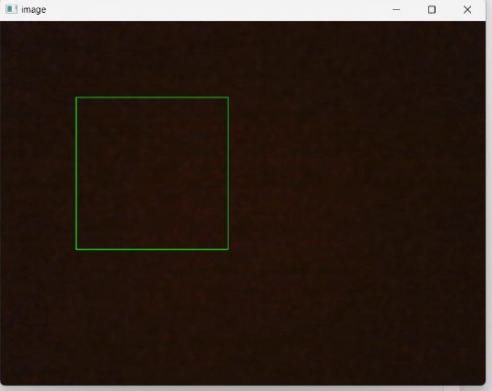
PROJECT DEMONSTRATION
2022 - 23
AI CRICKET SCORE
Figure 6 : Window to capture gestures
33

Slide 34
PROJECT DEMONSTRATION
2022 - 23
AI CRICKET SCORE
Module 2 : Preprocessing the Gesture and Umpire Dataset
The code reads images from a directory called "Dataset".
It converts the images to grayscale and performs thresholding using Otsu's method.
The thresholded images are resized to 50x50 pixels.
A new directory is created for each image category in the "Preprocessed/Train" directory.
The preprocessed images are saved in their respective category directories.
34

Slide 35
PROJECT DEMONSTRATION
2022 - 23
AI CRICKET SCORE
Module 3 : Training & Testing of Gestures and Umpire using Densenet121
The "121" in DenseNet121 refers to the number of layers in the network.
The network consists of a convolutional layer, dense blocks, and a final classification layer.
The convolutional layer serves as the input layer, while the dense blocks are composed of multiple layers with dense connectivity.
The final classification layer uses global average pooling to produce the output probabilities.
The benefits of DenseNet121 includes better use of features from earlier layers due to the dense connectivity pattern.
Additionally, it has fewer parameters than other deep neural network architectures, making it more efficient to train and less prone to overfitting.
35

Slide 36
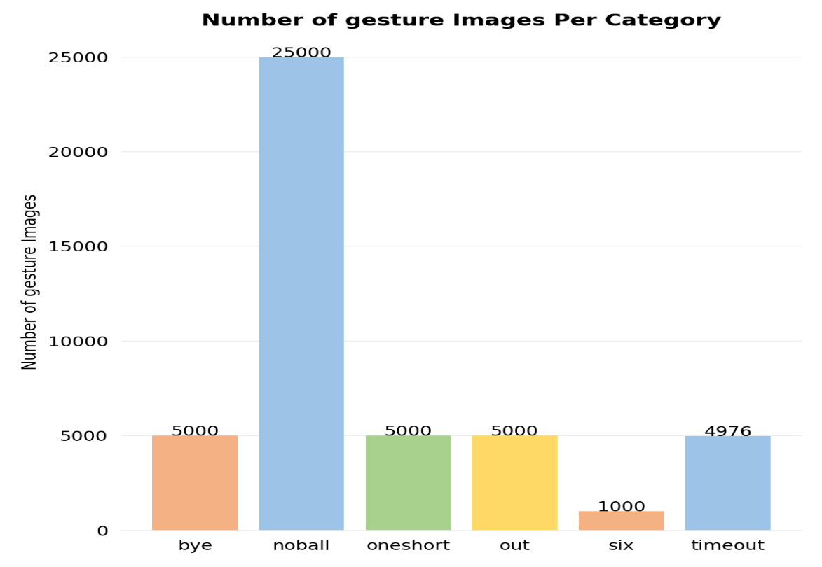
PROJECT DEMONSTRATION
2022 - 23
AI CRICKET SCORE
Figure 7 : Number of Gesture Images per Category
36

Slide 37
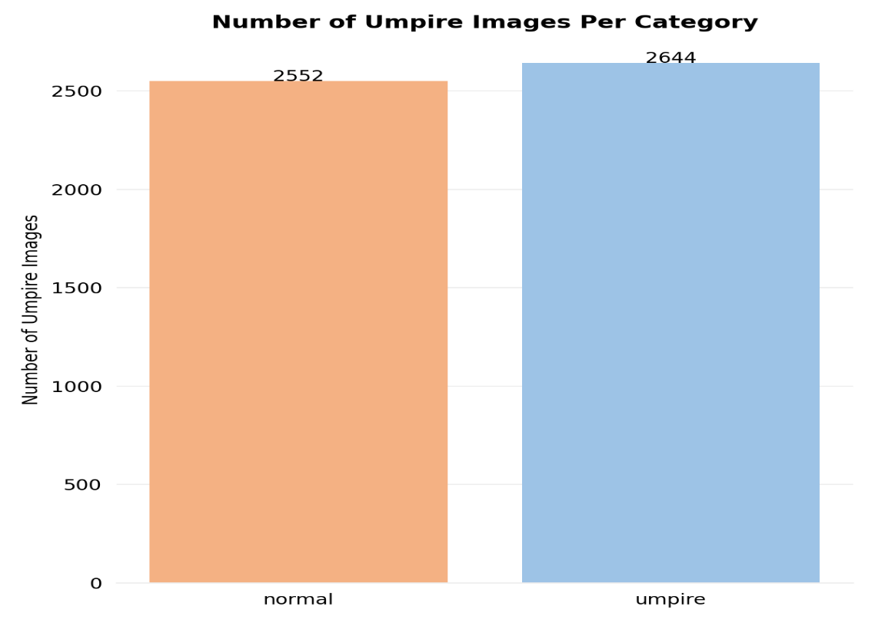
PROJECT DEMONSTRATION
2022 - 23
AI CRICKET SCORE
Figure 8 : Number of Umpire Images per Category
37

Slide 38
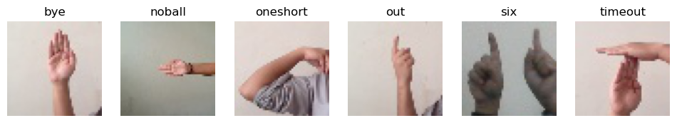
PROJECT DEMONSTRATION
2022 - 23
AI CRICKET SCORE
Figure 9 : Random Gestures Per Category
38

Slide 39
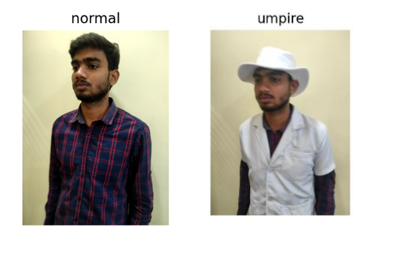
PROJECT DEMONSTRATION
2022 - 23
AI CRICKET SCORE
Figure 10 : Random Umpire and Non Umpire Image
39

Slide 40
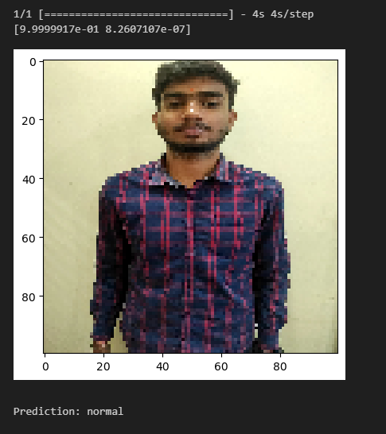
PROJECT DEMONSTRATION
2022 - 23
AI CRICKET SCORE
Figure 11 : Prediction of Non - Umpire using test dataset
40

Slide 41
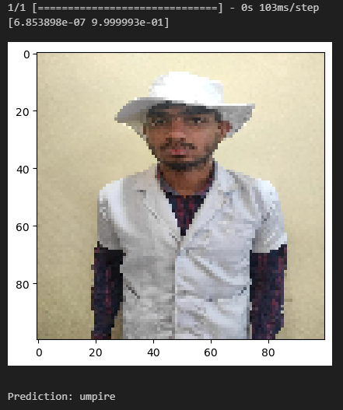
PROJECT DEMONSTRATION
2022 - 23
AI CRICKET SCORE
Figure 12 : Prediction Umpire using test dataset
41

Slide 42
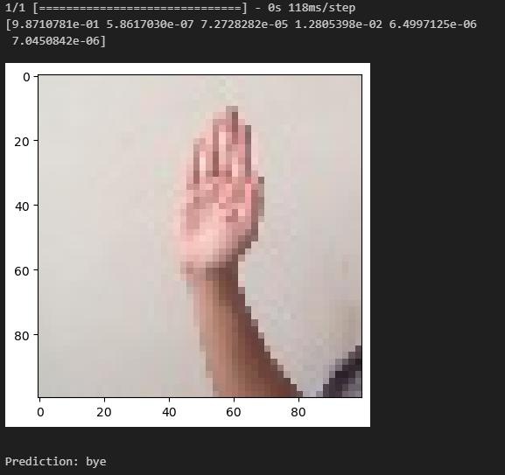
PROJECT DEMONSTRATION
2022 - 23
AI CRICKET SCORE
Figure 13 : Prediction of “bye” using test dataset
42

Slide 43
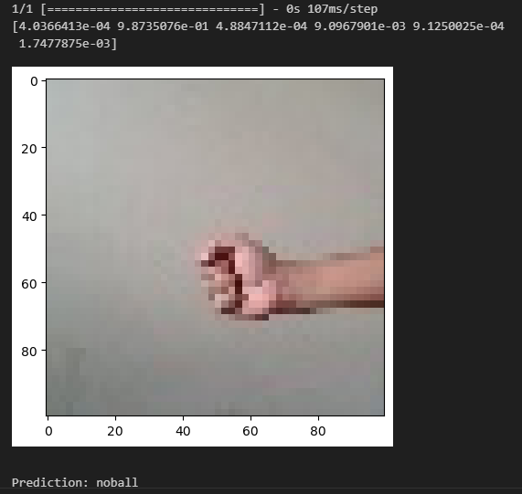
PROJECT DEMONSTRATION
2022 - 23
AI CRICKET SCORE
Figure 14 : Prediction of “noball” using test dataset
43

Slide 44
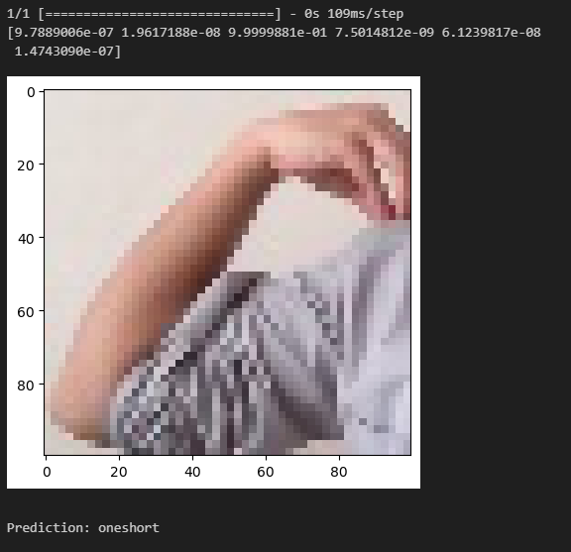
PROJECT DEMONSTRATION
2022 - 23
AI CRICKET SCORE
Figure 15 : Prediction of “oneshort” using test dataset
44

Slide 45
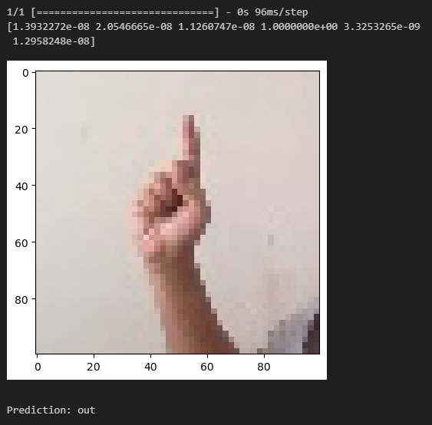
PROJECT DEMONSTRATION
2022 - 23
AI CRICKET SCORE
Figure 16 : Prediction of “out” using test dataset
45

Slide 46
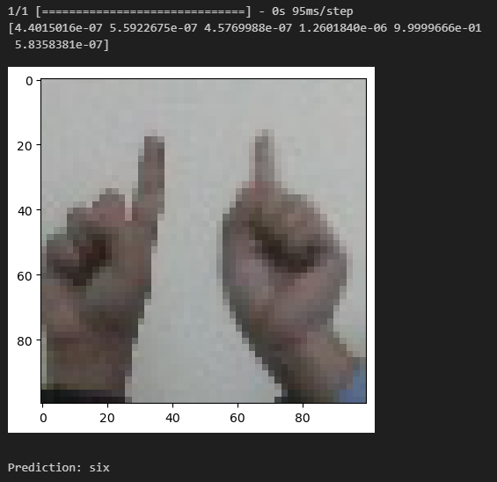
PROJECT DEMONSTRATION
2022 - 23
AI CRICKET SCORE
Figure 17 : Prediction of “six” using test dataset
46

Slide 47
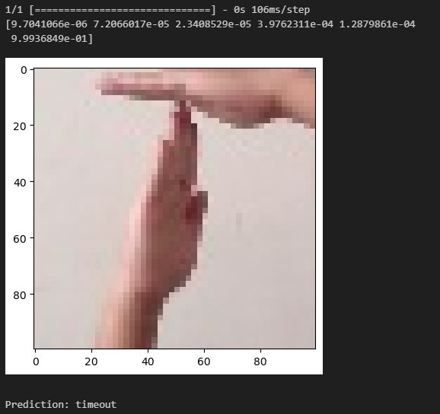
PROJECT DEMONSTRATION
2022 - 23
AI CRICKET SCORE
Figure 18 : Prediction of “timeout” using test dataset
47

Slide 48
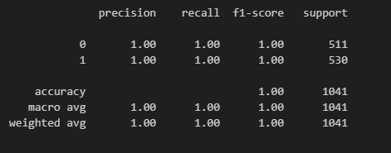
PROJECT DEMONSTRATION
2022 - 23
AI CRICKET SCORE
Figure 19 : Accuracy of trained Umpire Model using Densenet121
48

Slide 49
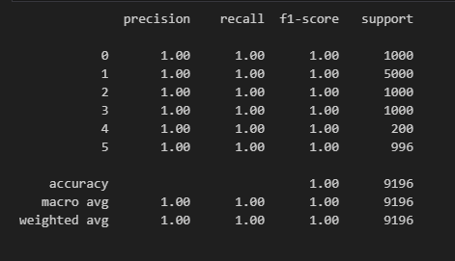
PROJECT DEMONSTRATION
2022 - 23
AI CRICKET SCORE
Figure 20 : Accuracy of trained Gesture Model using Densenet121
49

Slide 50
PROJECT DEMONSTRATION
2022 - 23
AI CRICKET SCORE
Module 4 : Umpire Detection Using Live Camera
The image classification module uses a pre-trained DenseNet121 model from the Keras library to predict the class of an input image.
The module provides a function called "predict" that takes an image path (“img.jpg”) as input and returns the predicted class label of the image.
The function first loads the input image using the Keras utility function, resizes it to (100, 100) pixels, and then converts it to a NumPy array. The array is then normalized by dividing it by 255.
The pre-trained model is used to predict the class label of the image, which is returned by the function.
The module also writes the predicted class label to a text file called "output.txt".
50

Slide 51
PROJECT DEMONSTRATION
2022 - 23
AI CRICKET SCORE
Module 5 : Gesture Detection Using Live Camera
This module implements a live camera application that performs gesture recognition for umpire.
It captures and saves a constant stream of image inside of a green box presented where gesture is to be detected as ‘1.jpg’.
The module provides a function called "predict" that takes an image path (“1.jpg”) as input and returns the predicted class label of the image.
The model then reads “result.txt” for umpire detection.
In case of umpire it will give the prediction.
51

Slide 52
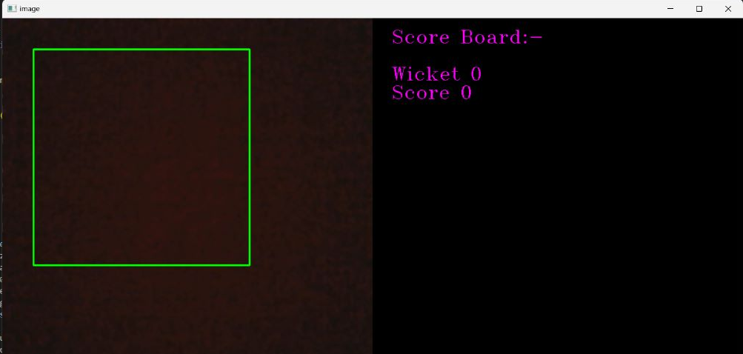
PROJECT OUTCOME
2022 - 23
AI CRICKET SCORE
To train the model using the collected umpire and gestures captured.
To predict the umpire signal and update the score board.
Figure 21 : Final output to predict the gesture
52

Slide 53
APPLICATIONS
2022 - 23
AI CRICKET SCORE
Sport’s score board updates.
Automation of Umpire signal.
AI into sports.
53

Slide 54
REFERENCES
2022 - 23
AI CRICKET SCORE
[1] Suvarna Nandyal and Suvarna Laxmikant Kattimani 2021 J. Phys.: Conf. Ser. 2070 012148
[2] M. Fernando and J. Wijayanayaka, "Low cost approach for real time sign language recognition," 2013 IEEE 8th International Conference on Industrial and Information Systems, 2013, pp. 637-642, doi: 10.1109/ICIInfS.2013.6732059.
[3] M. Z. Islam, M. S. Hossain, R. ul Islam and K. Andersson, "Static Hand Gesture Recognition using Convolutional Neural Network with Data Augmentation," 2019 Joint 8th International Conference on Informatics, Electronics & Vision (ICIEV) and 2019 3rd International Conference on Imaging, Vision & Pattern Recognition (icIVPR), 2019, pp. 324-329, doi: 10.1109/ICIEV.2019.8858563.
[4] E. Kaya and T. Kumbasar, "Hand Gesture Recognition Systems with the Wearable Myo Armband," 2018 6th International Conference on Control Engineering & Information Technology (CEIT), 2018, pp. 1-6, doi: 10.1109/CEIT.2018.8751927.’
[5] Lesha Bhansali and Meera Narvekar. Gesture Recognition to Make Umpire Decisions. International Journal of Computer Applications 148(14):26-29, August 2016.
54

Slide 55
REFERENCES
2022 - 23
AI CRICKET SCORE
[6] Suvarna Nandyal and Suvarna Laxmikant Kattimani 2021 J. Phys.: Conf. Ser. 2070 012148
[7] Y. Madhuri, G. Anitha. and M. Anburajan., "Vision-based sign language translation device," 2013 International Conference on Information Communication and Embedded Systems (ICICES), 2013, pp. 565-568, doi: 10.1109/ICICES.2013.6508395.
[8] Nusirwan Anwar bin Abdul Rahman, Kit Chong Wei and John See Faculty of Information Technology, Multimedia University.
[9] Moin, A., Zhou, A., Rahimi, A. et al. A wearable biosensing system with in-sensor adaptive machine learning for hand gesture recognition. Nat Electron 4, 54–63 (2021). https://doi.org/10.1038/s41928-020-00510-8.
[10] A. Ravi, H. Venugopal, S. Paul and H. R. Tizhoosh, "A Dataset and Preliminary Results for Umpire Pose Detection Using SVM Classification of Deep Features," 2018 IEEE Symposium Series on Computational Intelligence (SSCI), 2018, pp. 1396-1402, doi: 10.1109/SSCI.2018.8628877.
55

Slide 56
REFERENCES
2022 - 23
AI CRICKET SCORE
[11] M. A. Shahjalal, Z. Ahmad, R. Rayan and L. Alam, "An approach to automate the scorecard in cricket with computer vision and machine learning," 2017 3rd International Conference on Electrical Information and Communication Technology (EICT), 2017, pp. 1-6, doi: 10.1109/EICT.2017.8275204.
[12] Dadgostar, Farhad & Barczak, Andre & Sarrafzadeh, Abdolhossein. (2005). A Color Hand Gesture Database for Evaluating and Improving Algorithms on Hand Gesture and Posture Recognition. Res. Lett. Inf. Math. Sci. 7. 127-134.
56

Slide 57
THANK YOU
AI CRICKET SCORE
2022 - 23
57

